Slide 1
Design and Implementation of a Road Sign and Road State Mobile Notification Application
GROUP 15
1
TASK 4

Slide 2
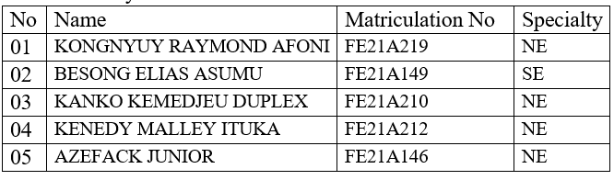
Members

Slide 3
SYSTEM MODELING AND DESIGN OUTLINE
1. Context diagram
2. Use case diagram
3. SEQUENCE DIAGRAM
CONCLUSION
Introduction
4. Class diagram
3. SEQUENCE DIAGRAM
2

Slide 4
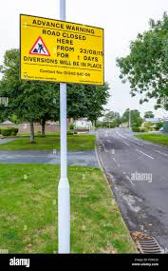
INTRODUCTION
This Task 4 focuses on the system modeling and design of a mobile application that provides drivers with crucial information about road signs, traffic conditions, and weather updates, aiding them in making safer driving decisions

Slide 5
The design process follows a structured approach, including various diagrams to model the system in order and comprehensively:
Context Diagram: Establishes the system foundation, detaling data flow and interactions between the user, the application, and backend services.
Use Case Diagram: Based on the context , it details the functionalities and interactions between the user and the application.
Sequence Diagram: Breaks down specific use cases into sequences of actions and messages between components.
Class Diagram: Defines the system's internal building blocks, their attributes, and methods.
Deployment Diagram: Illustrates the physical layout of the system components and their interactions. (can be created later).

Slide 6
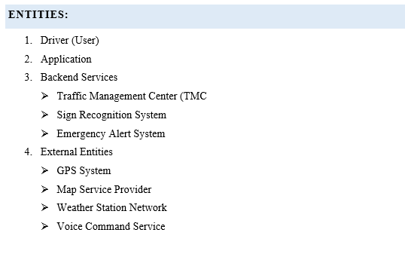
1. Context diagram

Slide 7
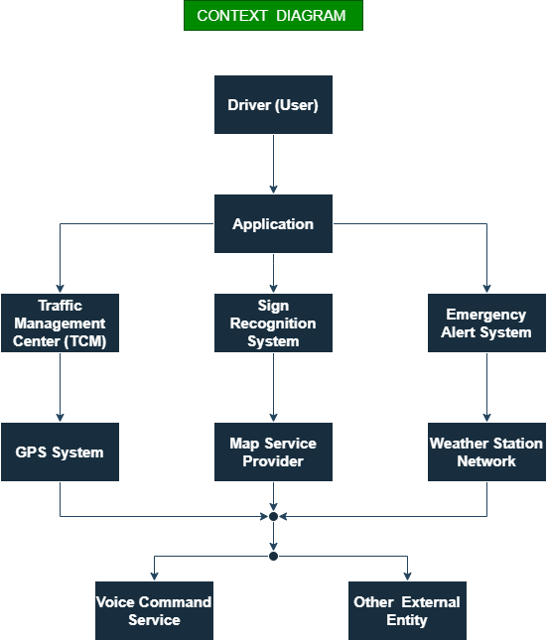

Slide 8
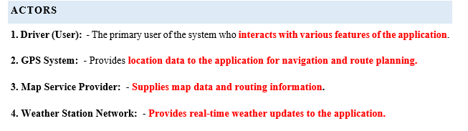
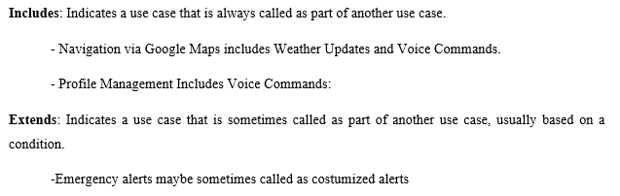
2. Use case diagram

Slide 9
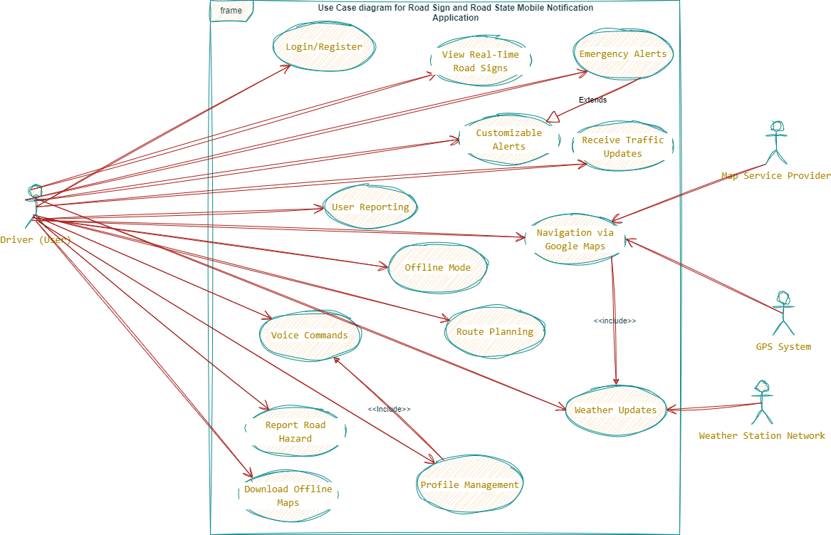

Slide 10
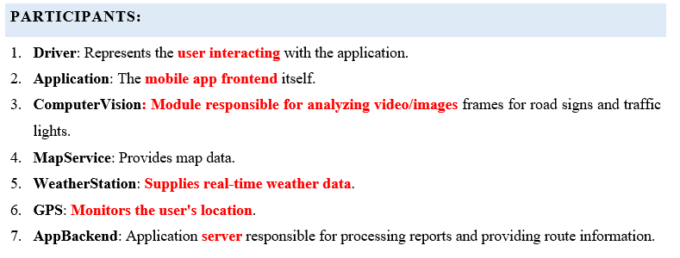
3. Sequence diagram

Slide 11
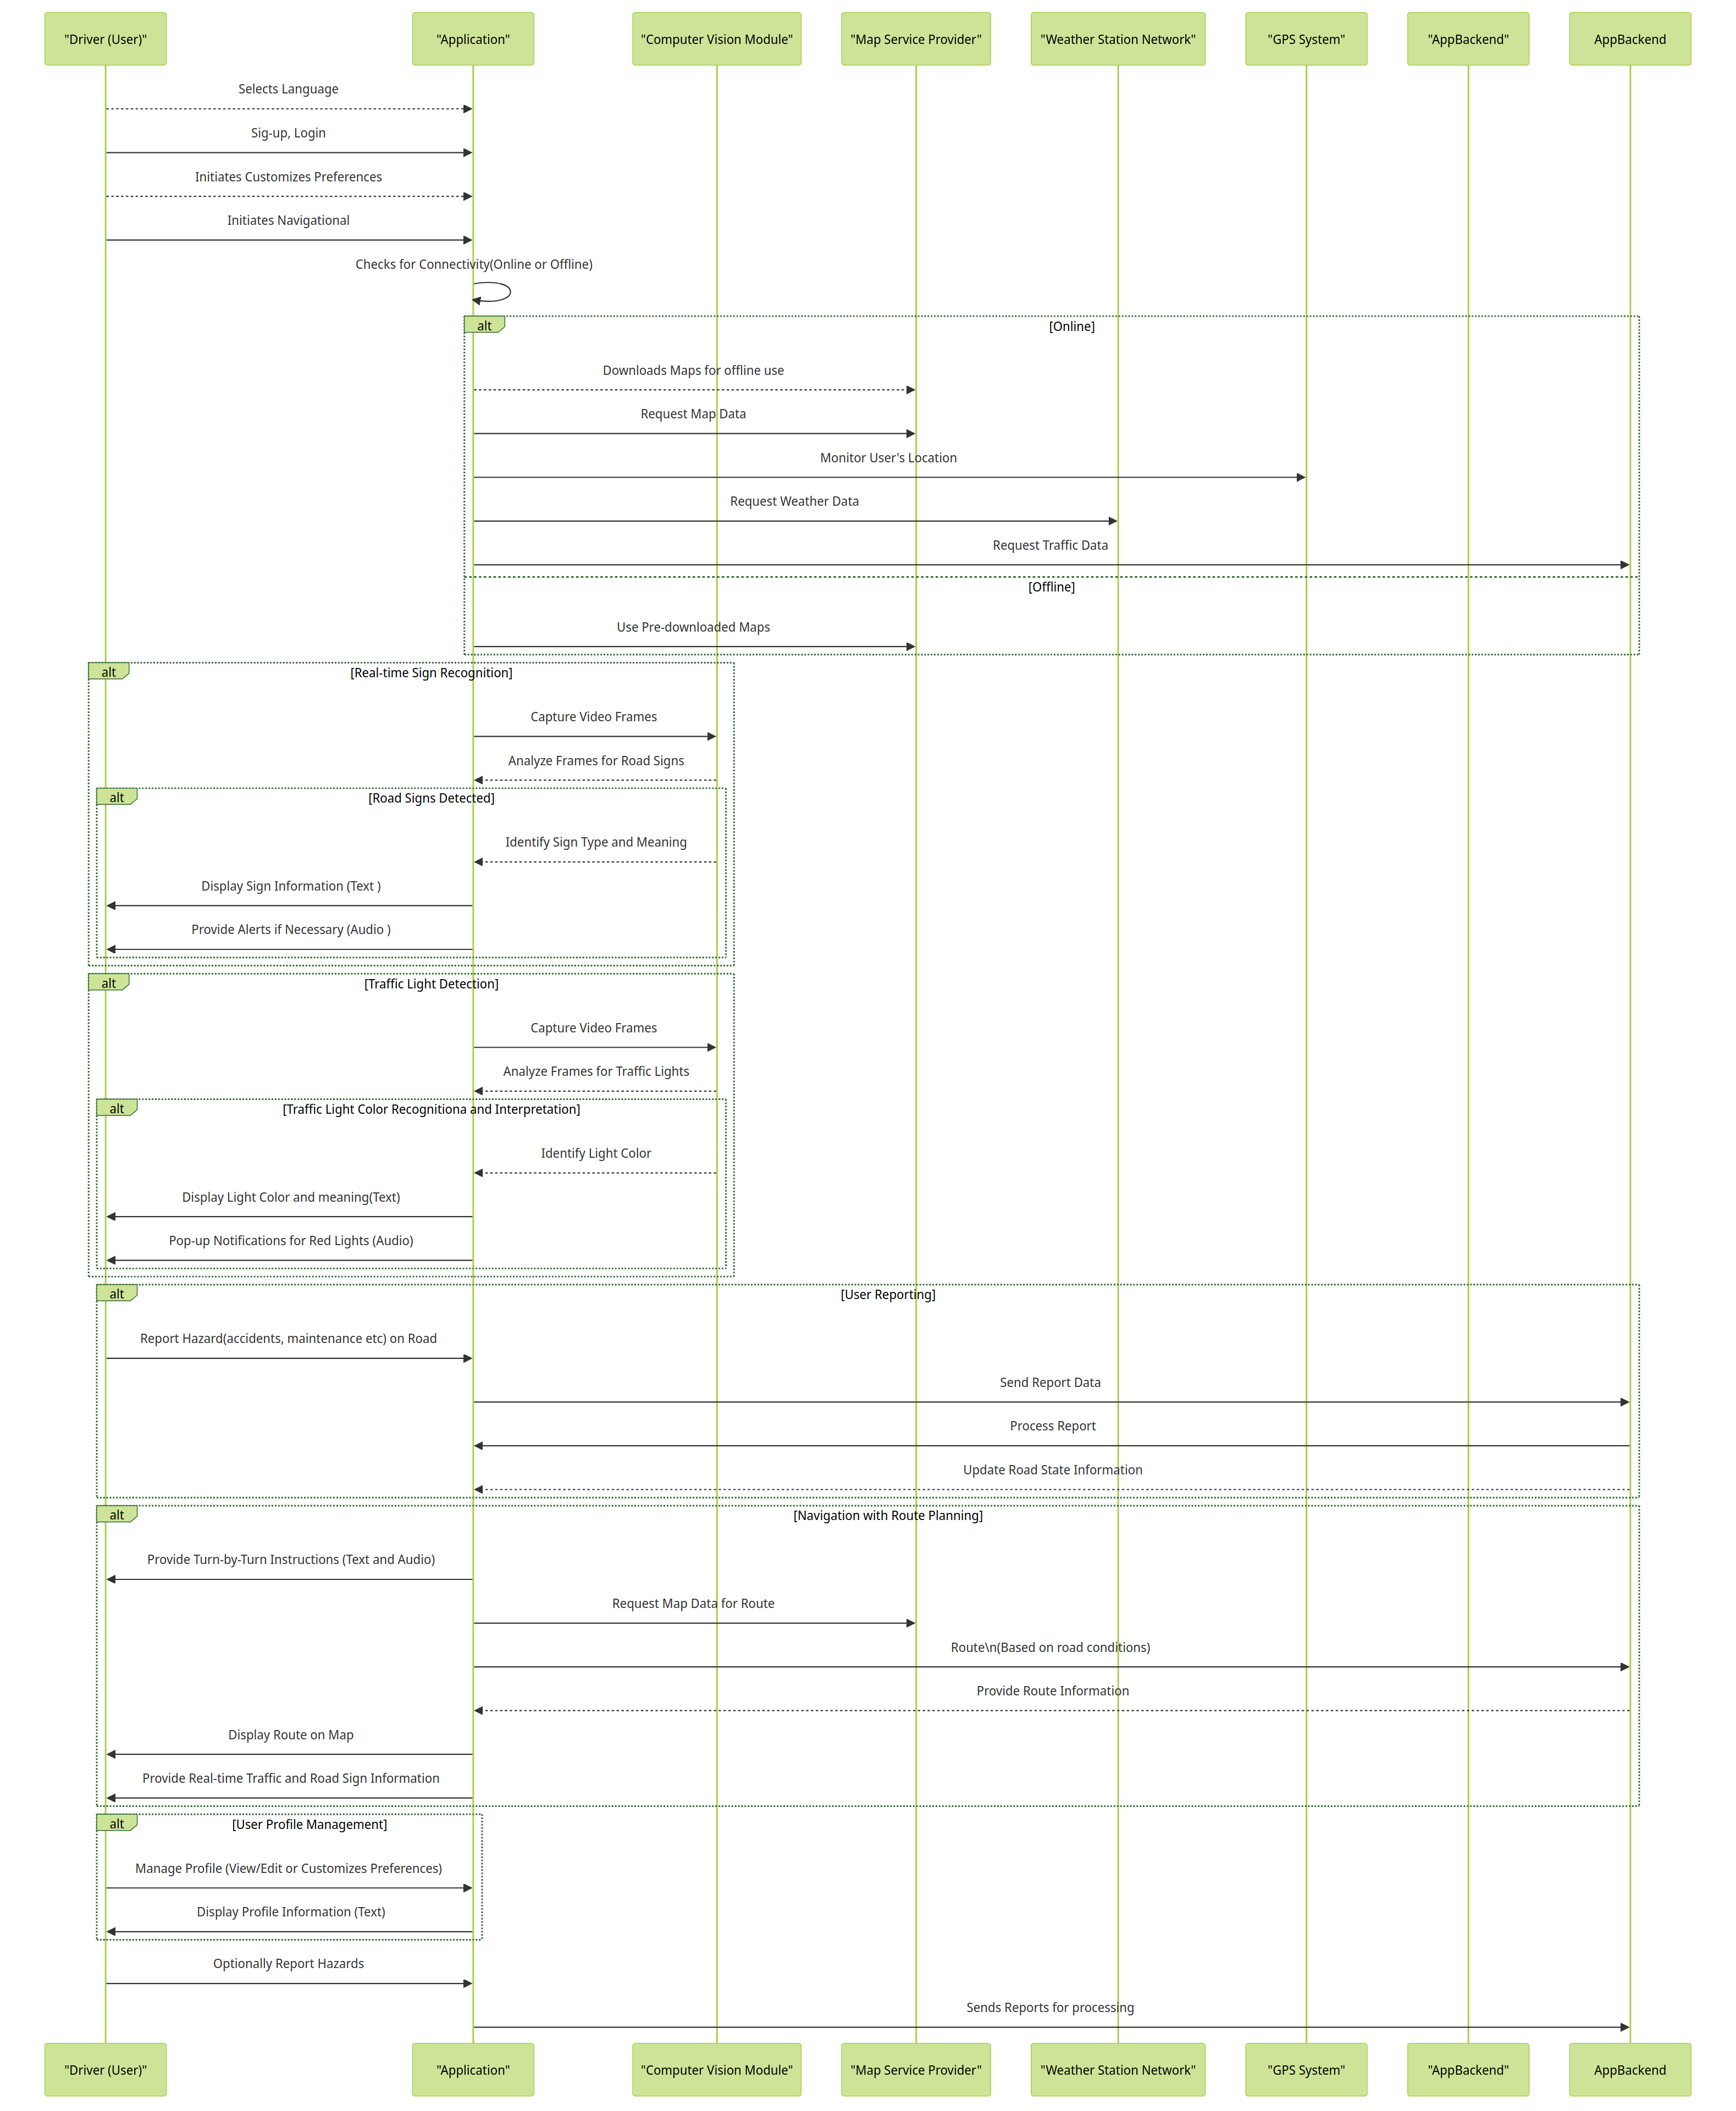

Slide 13
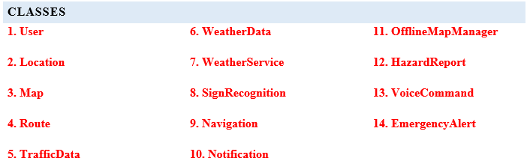
4. Class diagram

Slide 14
Class Relations
- User can receive multiple Notifications.
- User can save multiple Routes.
- Map contains multiple Routes.
- Route uses TrafficData and WeatherData.
- Navigation operates on a Route and uses TrafficData and WeatherData.
- SignRecognition informs Navigation.
- OfflineMapManager manages Map.
- HazardReport informs multiple Maps.
- VoiceCommand controls Navigation.
- EmergencyAlert triggers multiple Notifications.
- WeatherService updates WeatherData.
- Notification uses WeatherData.

Slide 15
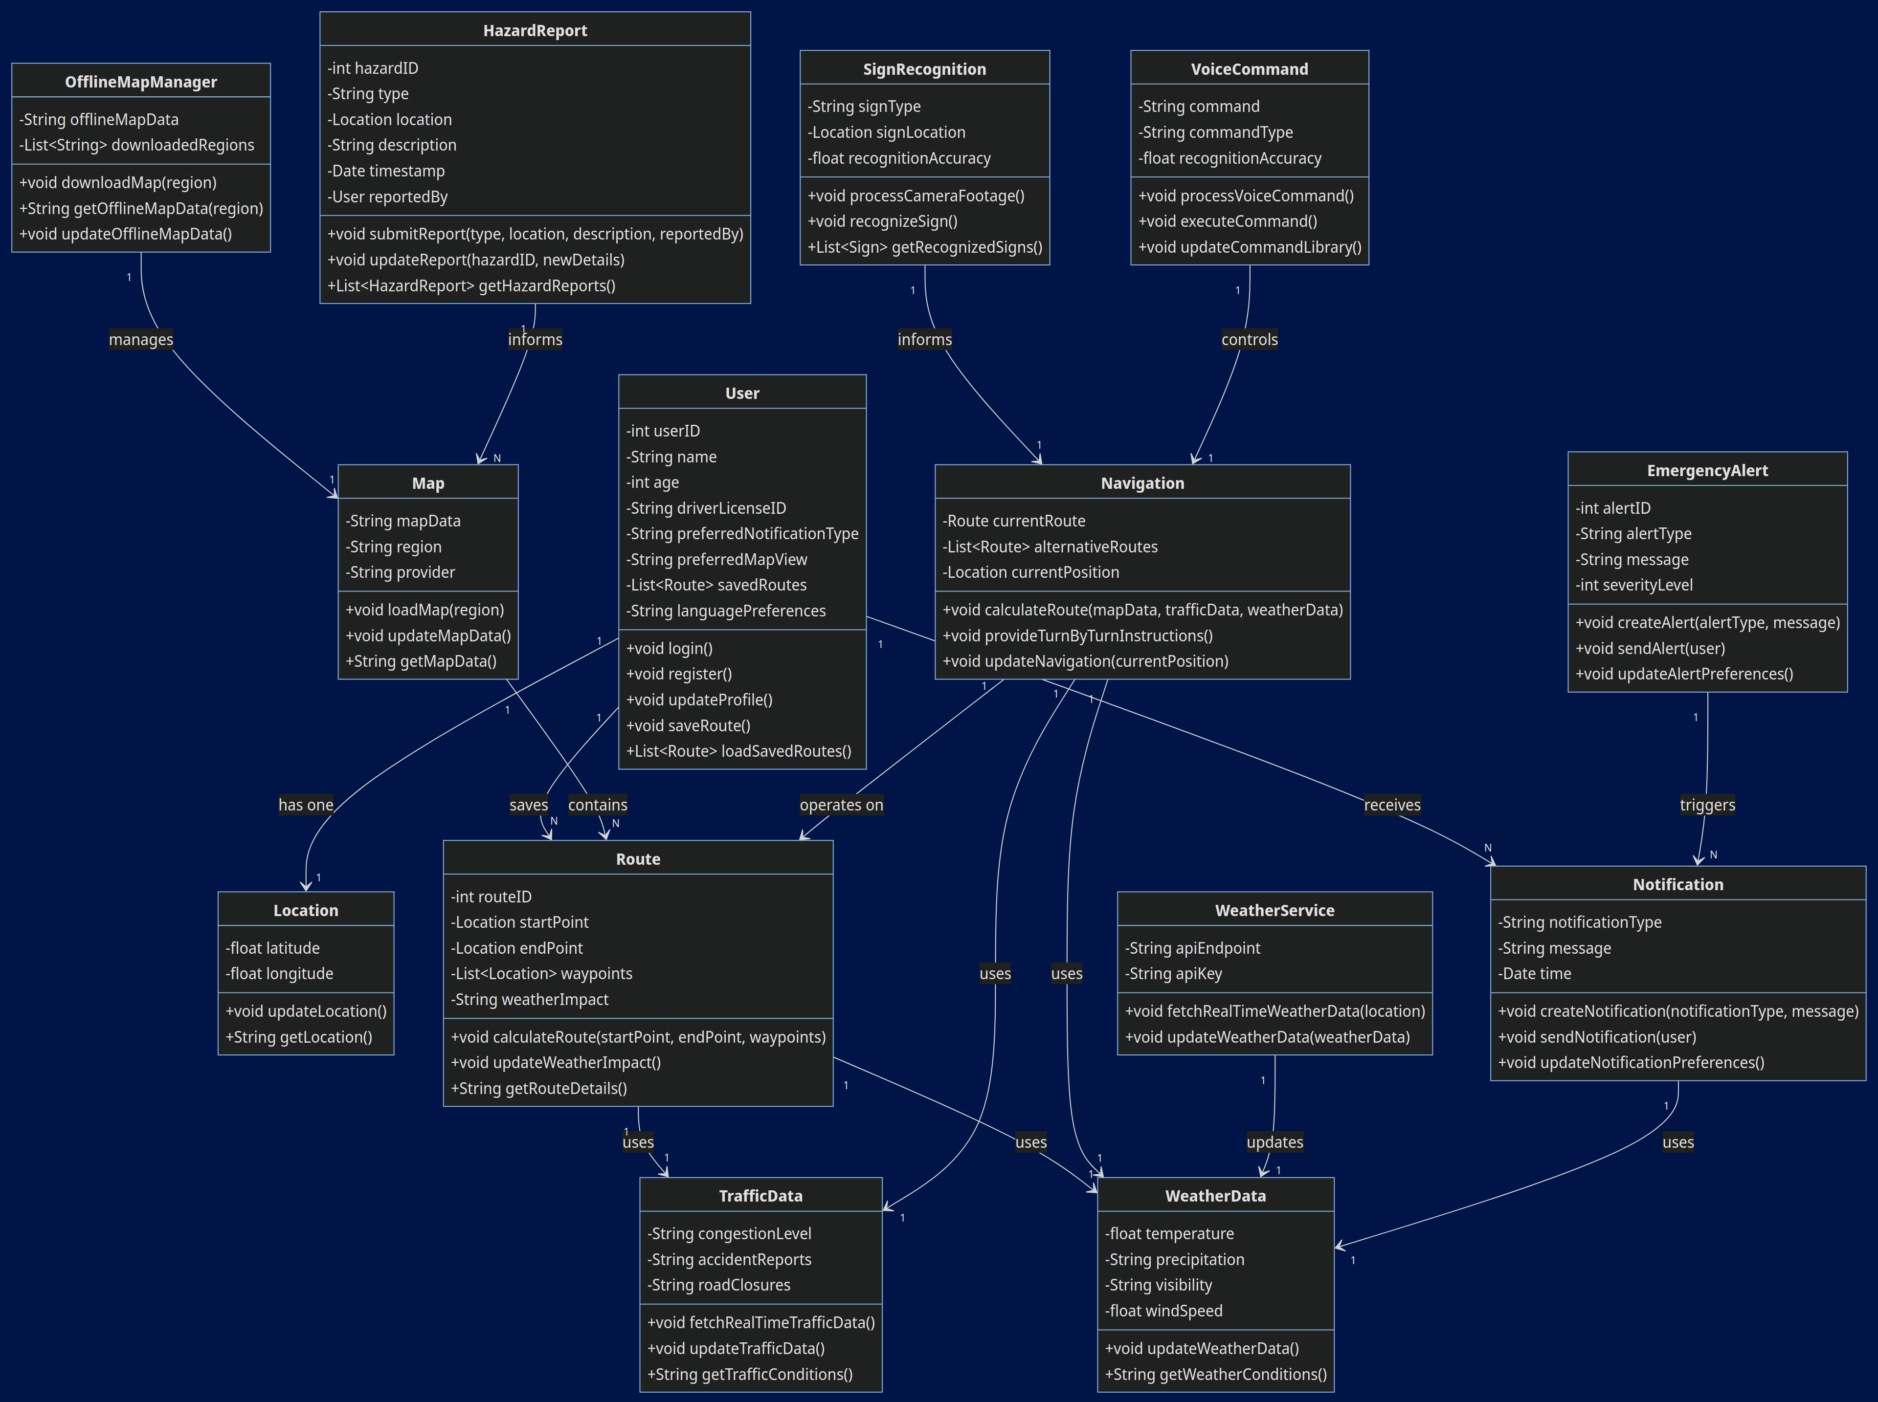

Slide 17
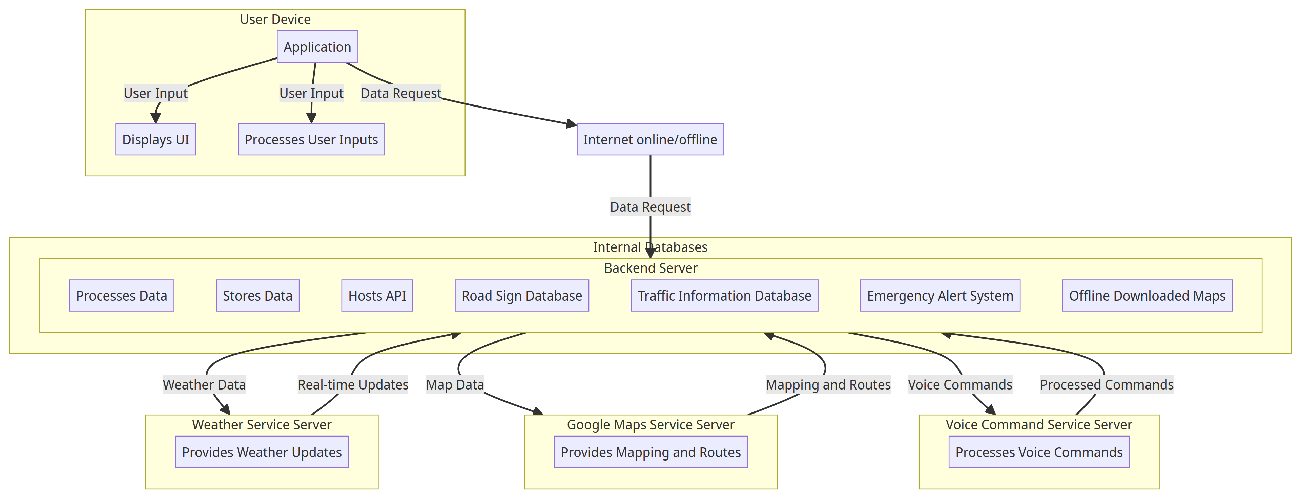
5. Deployment diagram

Slide 18
CONCLUSION
The detailed diagrams—context, use case, sequence, class, and deployment—serve as a robust framework guiding the development process.
This task lays the groundwork for a practical and efficient application that not only aids in safe driving but also sets a standard for future innovations in road safety technology.
The next phase involves implementing the design through UI development and integrating the modeled components to create a fully functional application that meets the needs of modern drivers.

Slide 19
THANK
YOU!!!!!

